Slide 1
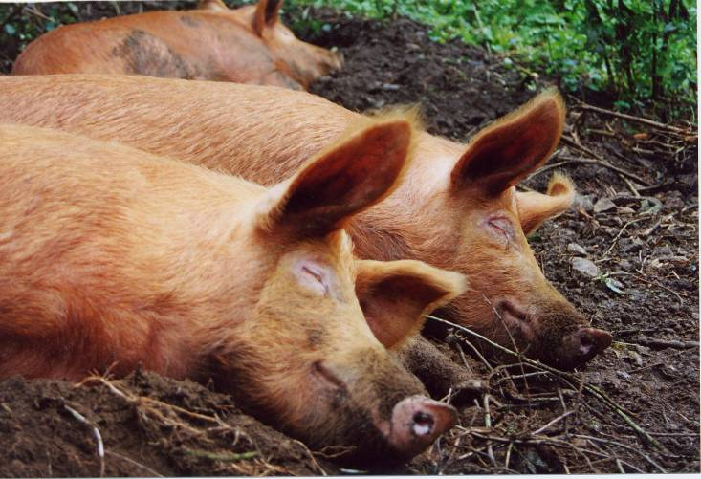
What do you know about pigs?
Notes:
Discuss anything they already know about pigs.
What do they look like?
What do they eat?
Have they seen pigs in real life and if so when? What were they doing?

Slide 2
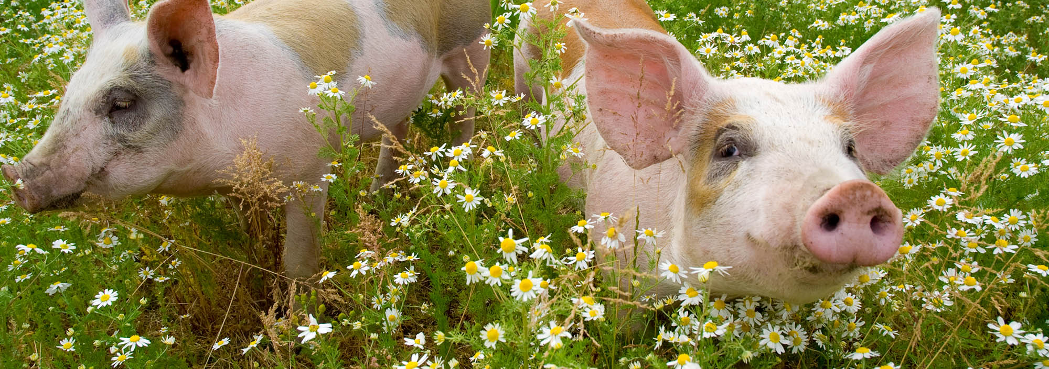
What do pigs do?
Go oink oink
Root in the earth
Make a nest
Walk
Play
Play-fight
Run around
Leap
Suckle their piglets / suckle from their mum
Rest
Sleep
Did you think of anything else?
These are all natural behaviours of pigs
Notes:
What do pigs do? What do you know about pigs? What noise do they make?
These will appear one at a time so there is a chance to discuss.

Slide 3
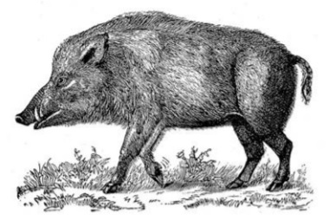
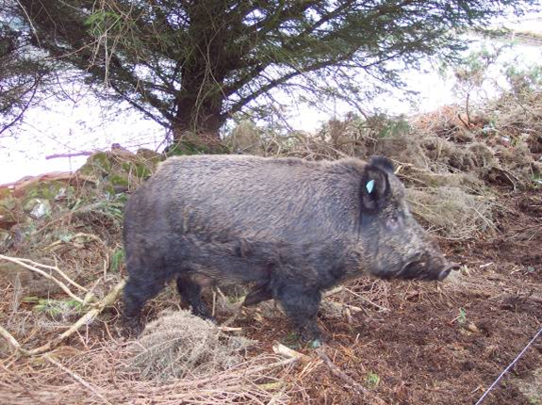
Wild Boar – Pigs’ Natural Ancestor
Is this boar similar to the pigs you have seen?
Watch the video to learn more!
The video should start at 1m24 and needs stopping at 2m50.
https://youtu.be/QLNn3qg1RAE?t=84
Notes:
This is a wild boar, which is the ancestor of the pig. Do you think it looks similar to today’s pigs?
Watch the video.
Discuss. What does the boar like to do?

Slide 4
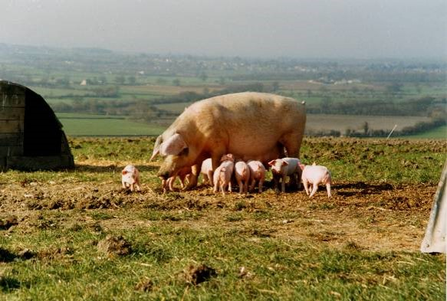
Farming sows
What is a sow?
A sow is what we call a mother pig.

Slide 5
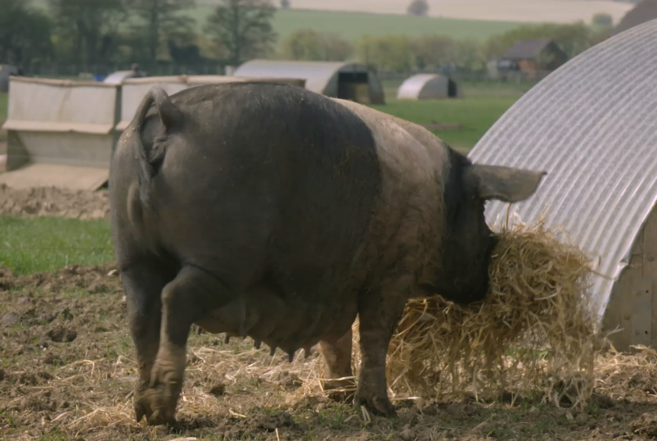
Pigs today have inherited their behaviour from the wild boar
What do you think this sow is doing?
She is about to give birth and is carrying straw to her nest!
Watch the video for an example.
https://www.youtube.com/watch?v=7I3w5SyCZDI
What happens next?
Notes:
Before giving birth the domestic sow behaves in the same way as the wild boar. This one is carrying straw to her nest
.
If possible watch the Mothers Day video here, to see more on the sows natural mothering behaviours. Link on website: (link)

Slide 6
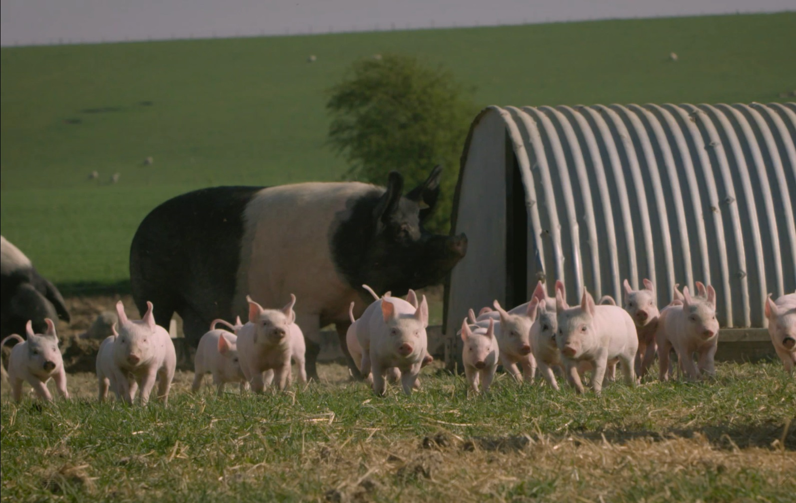
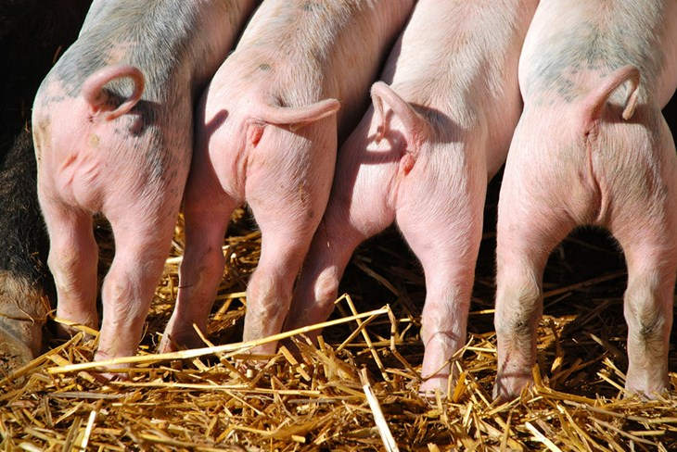
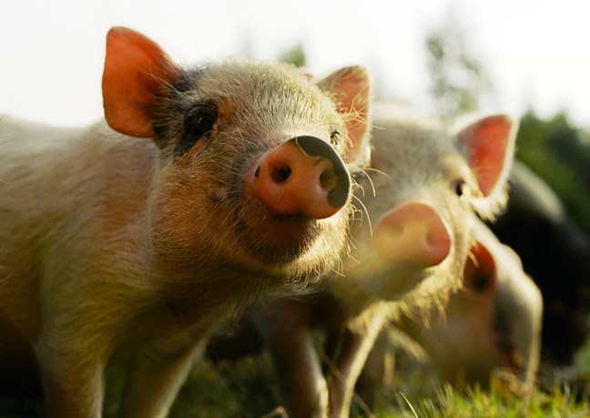
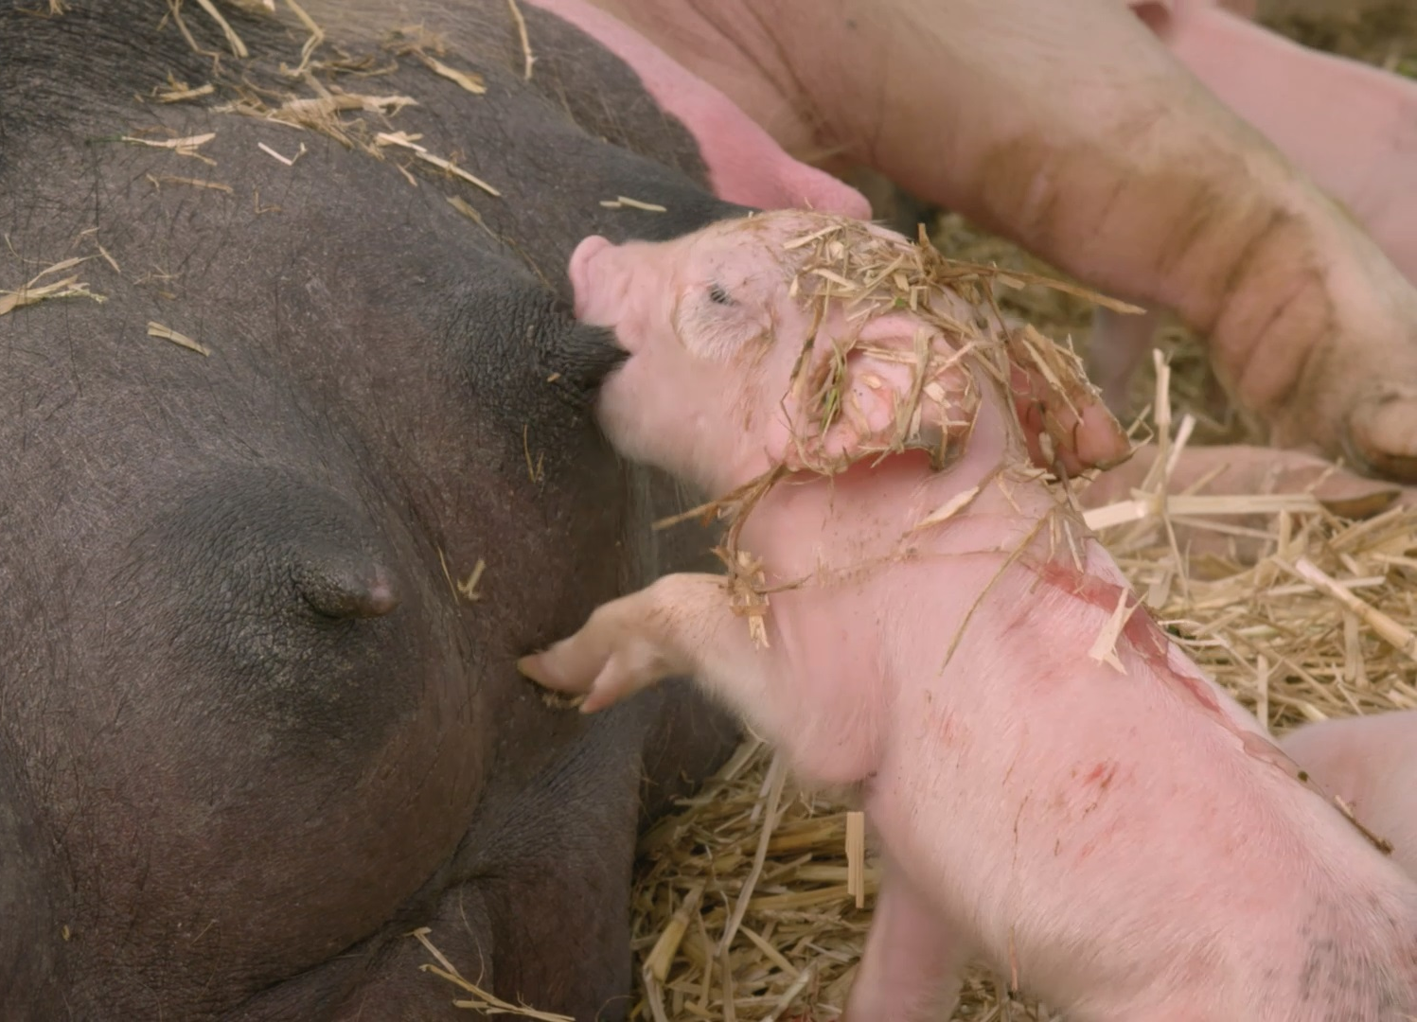
Piglets!
Notes:
Discuss what piglets might like to do.
Playing with each other.
Suckle their mother.

Slide 7
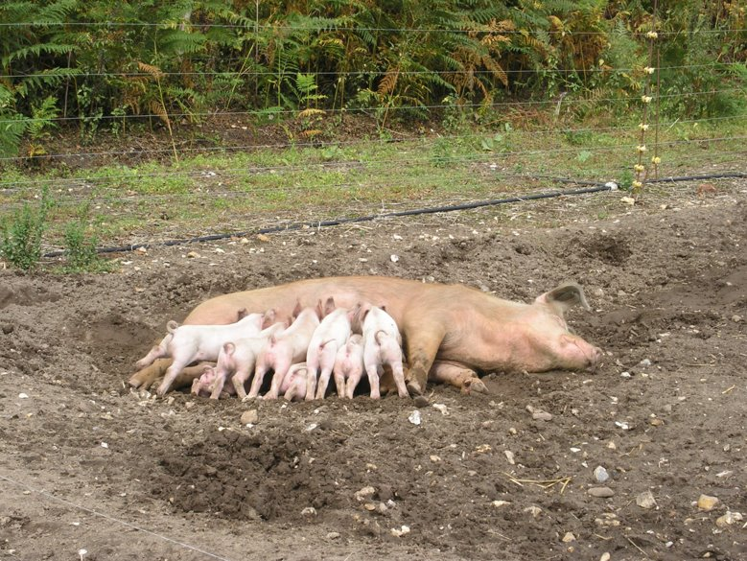
What is this sow doing?
Suckling her piglets.

Slide 8
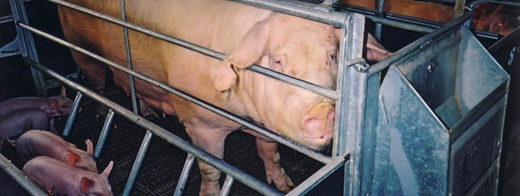
Some farmed sows cannot display their natural behaviours
Why do you think sows might be kept in a farrowing crate like this one?
Sometimes sows accidentally roll on their piglets. Farrowing crates can make this less likely.
Notes:
Some sows are kept in farrowing crates when they are giving birth. Their movement is limited so they can just turn around. The piglets have a small amount of space.
Discuss how the sow and piglet might feel. Displaying their natural behaviour is difficult.

Slide 9
What do you think the sow in the video is doing ?
https://www.youtube.com/watch?v=hTm1L6qWX0k&list=UUzl50zen6r82QRRE_rezOLw&index=25&t=0s
She is pushing her piglets out of the way before she lies down to stop them getting crushed.
Farming systems can also be designed to prevent crushing without putting the sow in a cage.

Slide 10
We farm sows in different ways...
1. Look at the next few pages. Which do you think is the best and why?
2. Rank them in order from best to worst.
Notes:
Look at each photo and think about which is best suited to the sow.

Slide 11
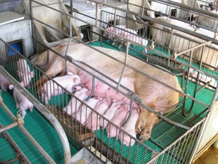
In farrowing crates...
There are bars to keep the sow separate from her piglets. This can help to prevent her crushing her piglets.
The sow cannot move easily.
The piglets will leave their mother at 3-4 weeks old.
The sow soon becomes pregnant again.

Slide 12
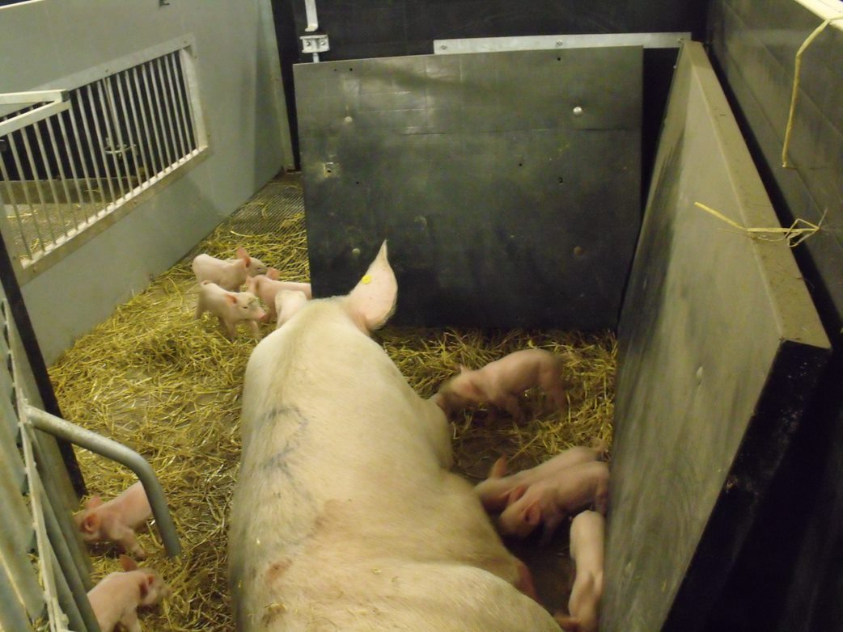
In farrowing pens...
The sow is always free to move.
The pen is designed so that the sow is less likely to crush her piglets.
The piglets are taken from their mother at 3-4 weeks old.
The sow produces more milk. This makes the piglets stronger.

Slide 13
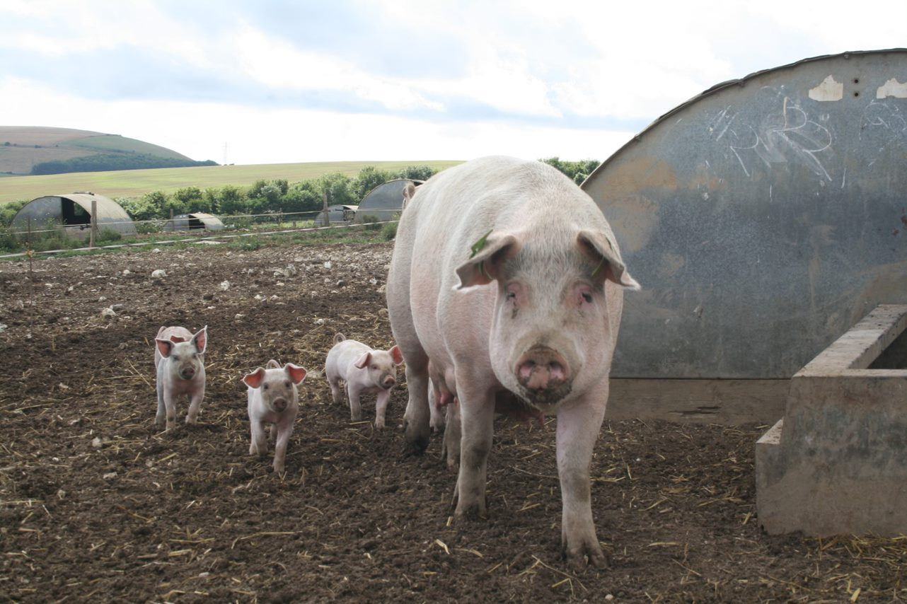
Free-range...
The sow and growing piglets live outside.
The sow is free to move and can make a nest.
The sow produces more milk. This helps the piglets grow stronger.
The sow has straw for bedding, rooting and chewing.
The piglets leave their mother at 3-4 weeks

Slide 14

Organically...
In the UK, nearly all organic sows are also kept free-range.
The piglets are also kept with their mother longer.
The piglets get to drink even more milk.
The piglets are less likely to be unwell and to need antibiotics.

Slide 15
Which do you think is best and why?
Rank them, with 1 being the best and 4 the worst.
Farrowing crate
Free-range​
Farrowing pen
Organic
What was your number 1?
2?
3?
4?
Notes:
Show
Then ask what they were doing.
Could they do this inside in a shed?

Slide 16
Now let's look at some more pig behaviours...

Slide 17
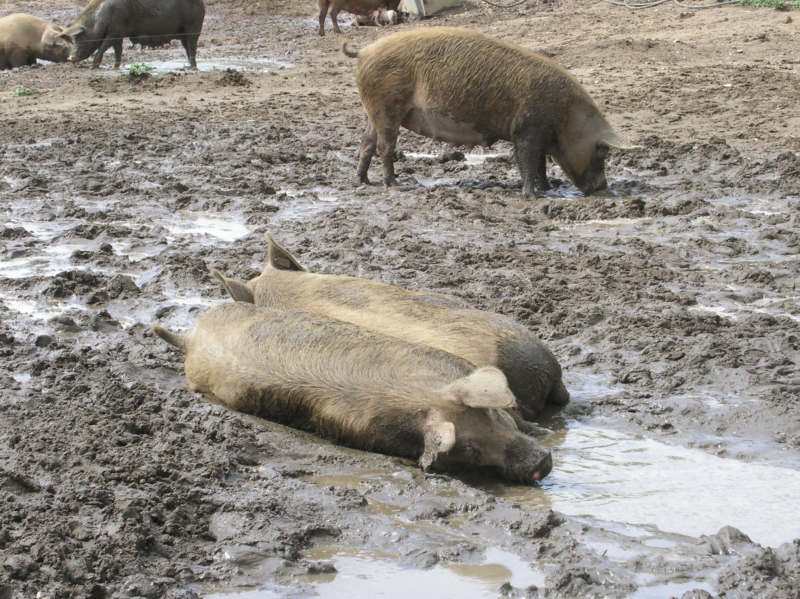
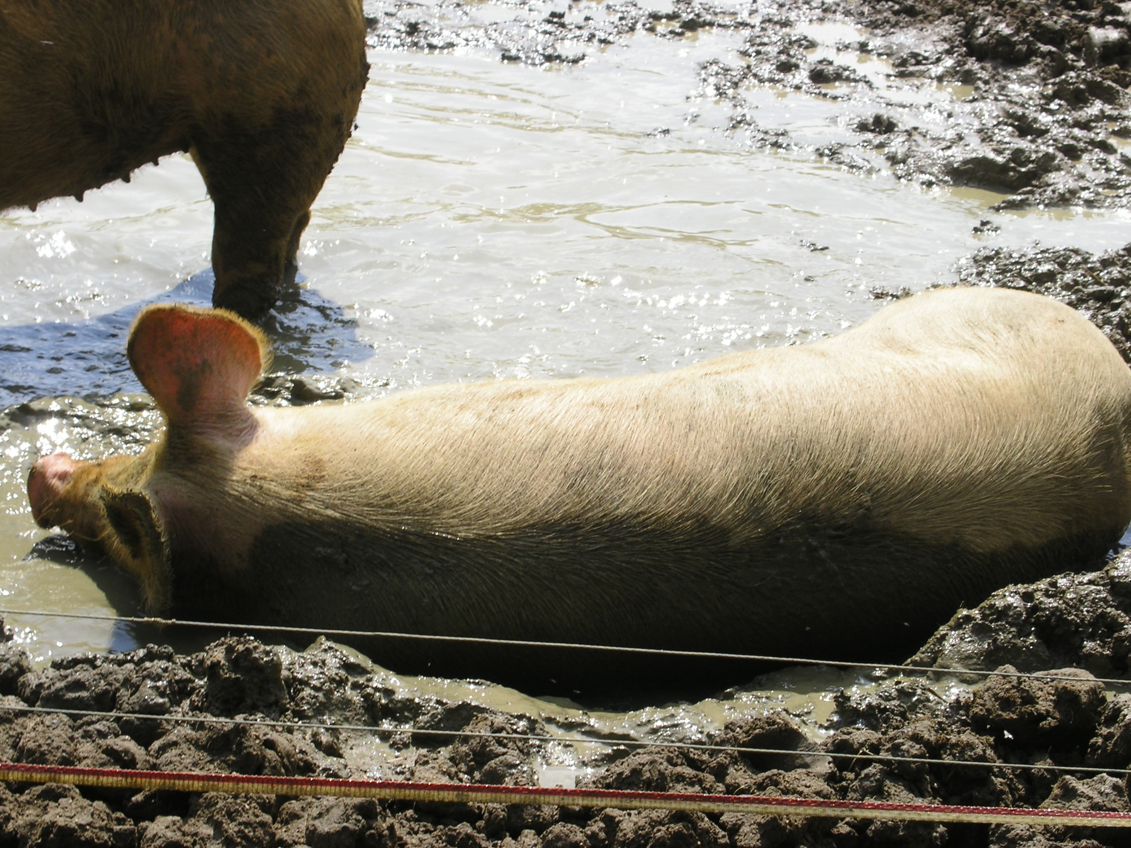
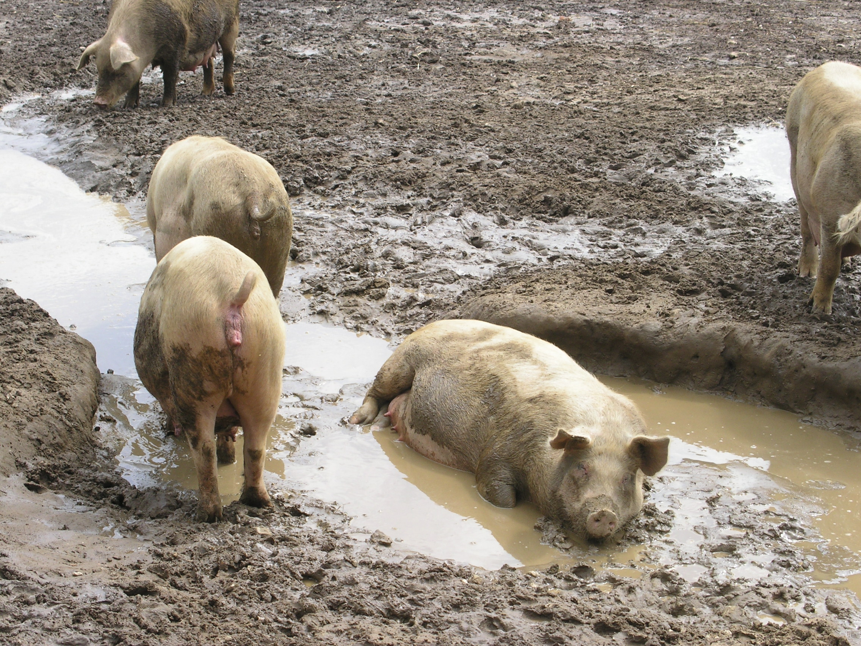
What are these pigs doing?
Wallowing in mud to keep cool and for sun-screen.
Watch the video for an example! https://www.youtube.com/watch?v=H34EYvDPciQ
Notes:
What do you think these pigs are doing?
They’re wallowing in the mud to keep cool and for sun-screen. This is something pigs enjoy very much.

Slide 18
What are these piglets doing?
Playing together and running freely. What fun!

Slide 19
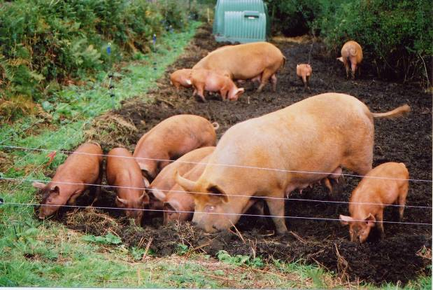
What are these pigs doing?
Rooting for food such as roots and worms! Yum!
Notes:
What do you think these pigs are doing? Discuss.
They’re rooting for food such as roots and worms! Pigs are very good at foraging for food.

Slide 20
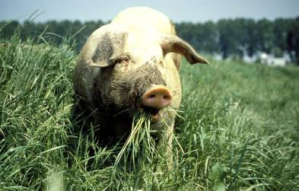
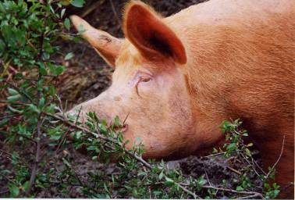
Pigs feed in lots of different ways. Can you match these words with the photos?
Grazing
Rooting
Browsing
…this is a thorn bush, so she must be careful!
Notes:
Pigs spend up to 9 hours a day foraging for food! Rooting, grazing and browsing.
The diet is high in fibre which helps to satisfy her hunger.

Slide 21
We saw how mother pigs are farmed. Now are going to look at how we farm piglets.
1. Look at the next few pages. Which do you think is the best and why?
2. Rank them in order from best to worst.
Notes:
Look at each photo and think about which is best suited to the sow.

Slide 22
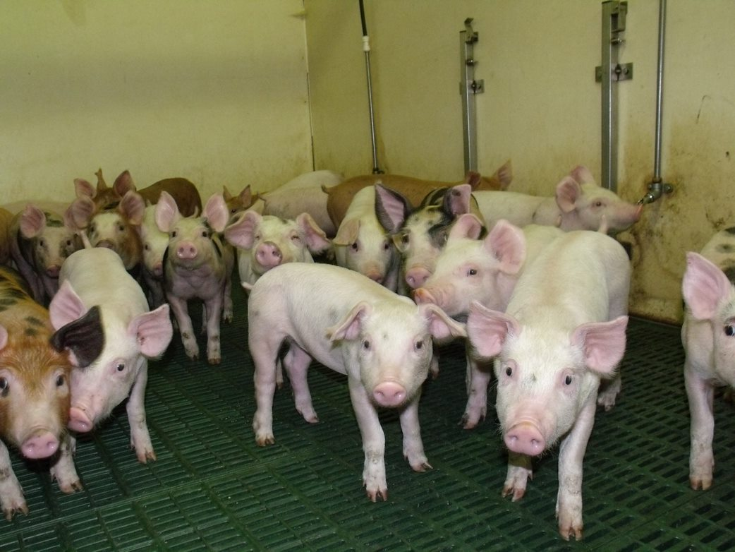
On bare floors...
The pigs are always kept indoors.
The pigs live on solid floors.
Sometimes the floors have gaps in. This is so the pigs waste can go through them.
Bored pigs sometimes bite each other's tails or ears.

Slide 23
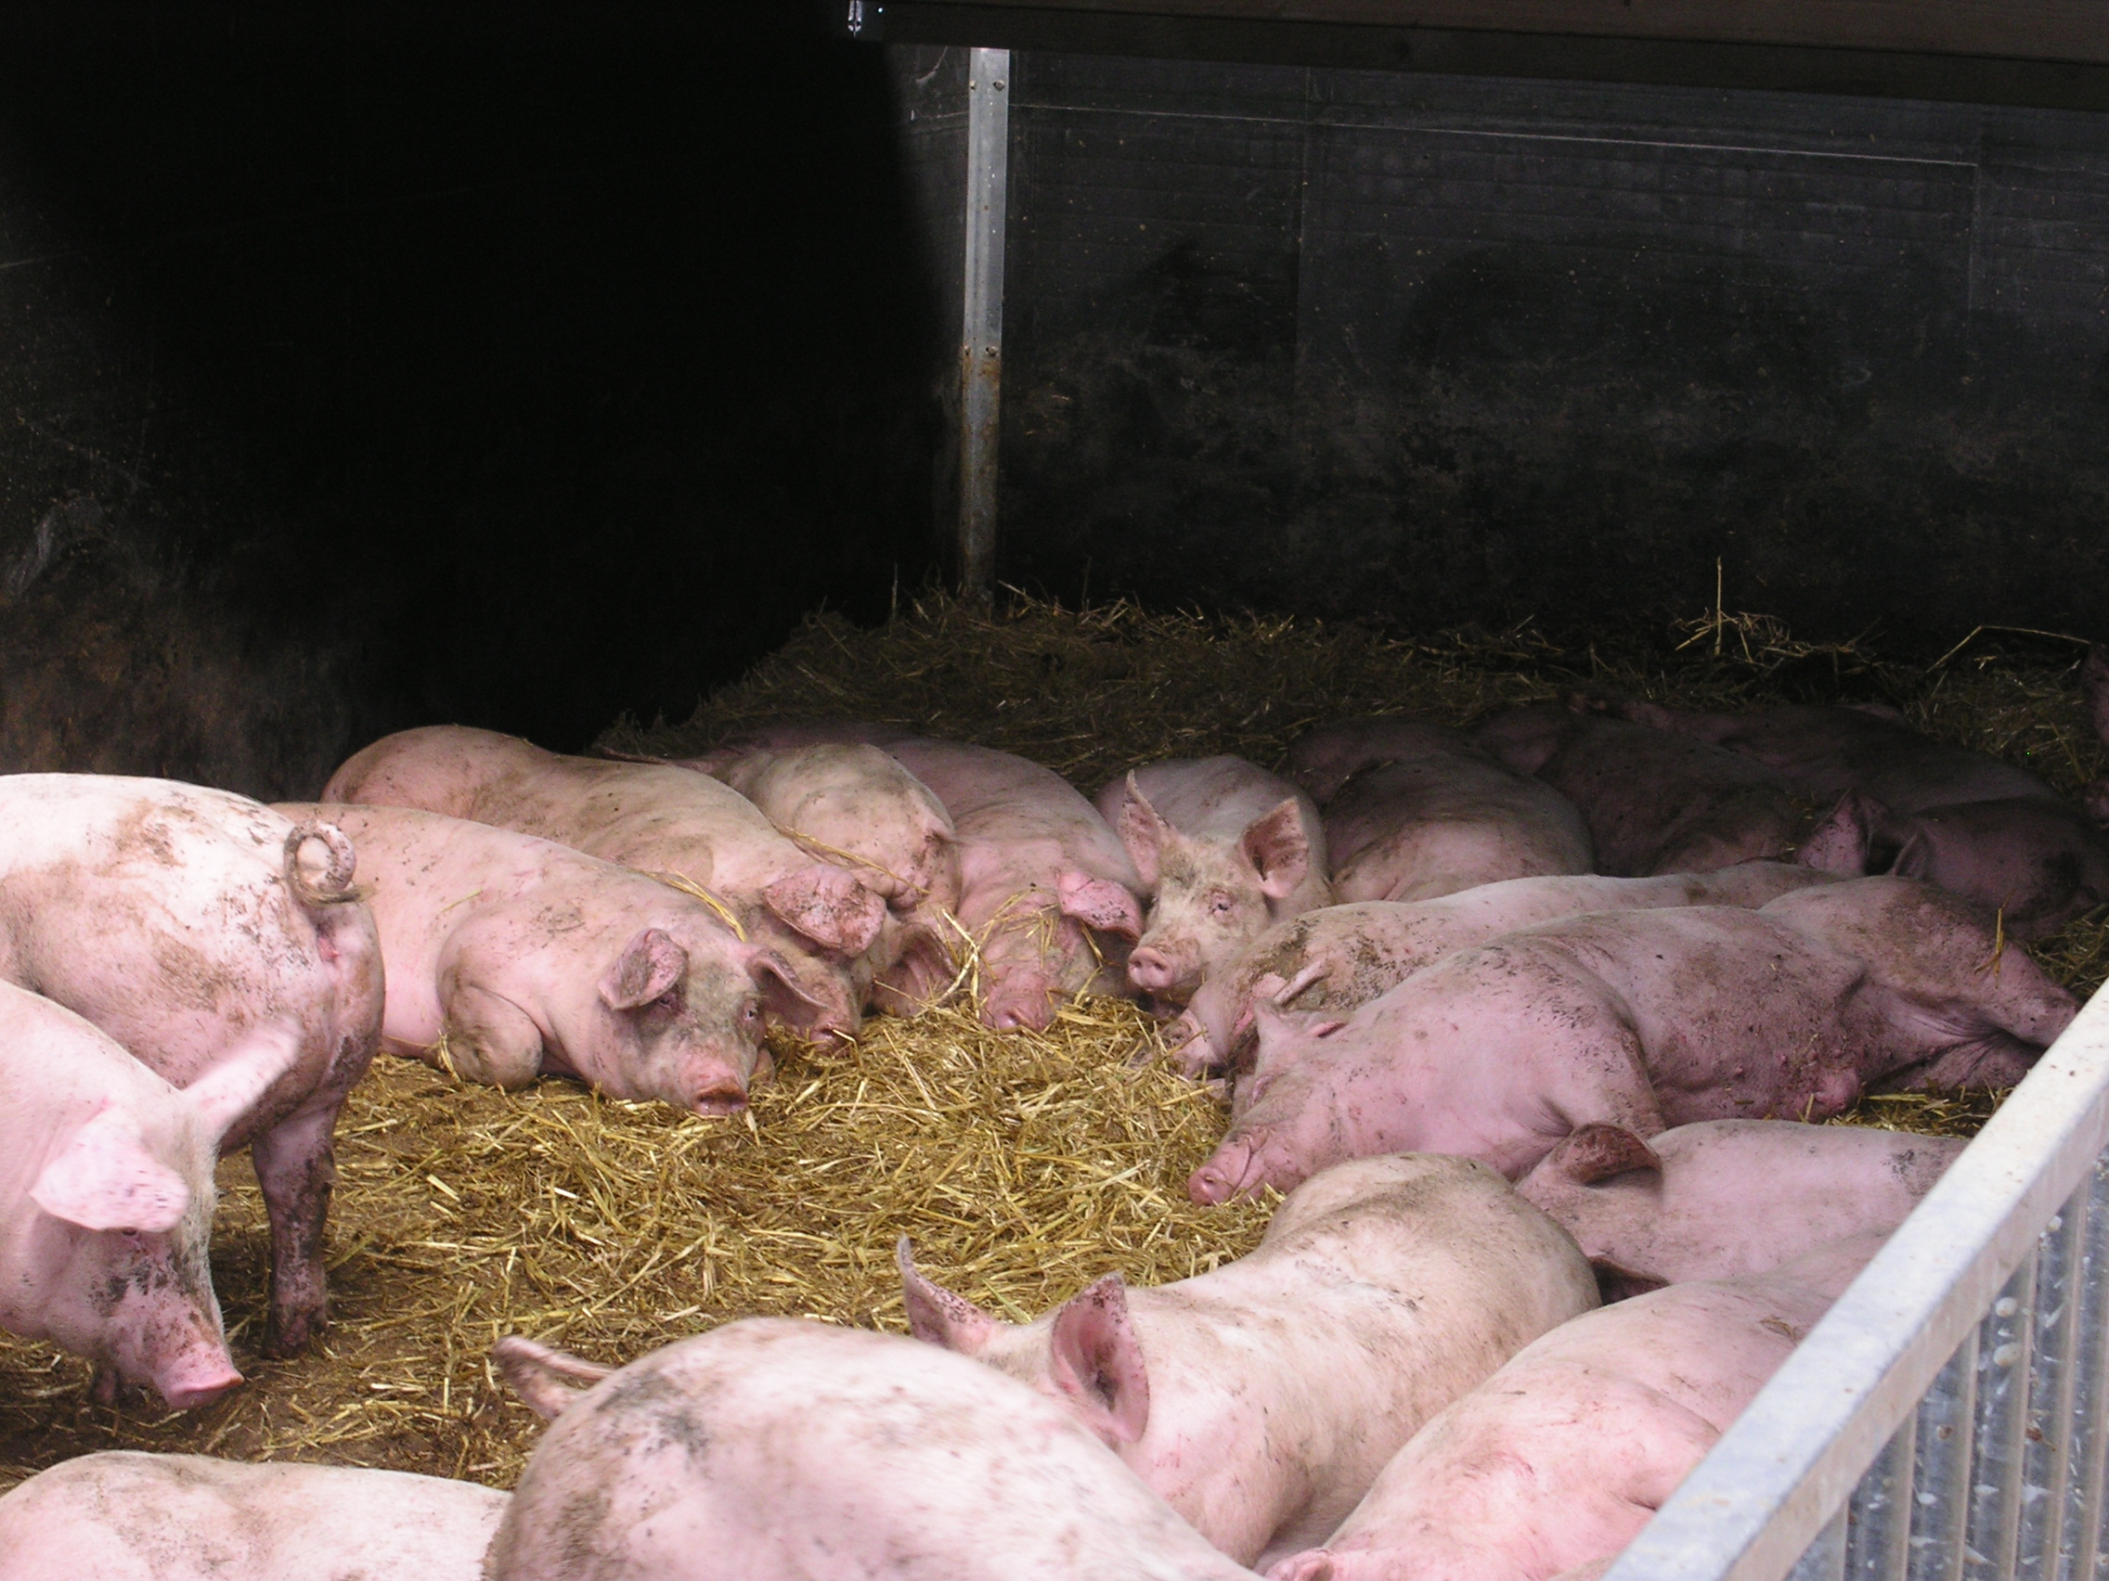
On straw...
The pigs are kept indoors.
The pigs have straw so they can root.
The pigs are less bored. They are less likely to bite each other's tails or ears.
The straw provides comfort and warmth.

Slide 24
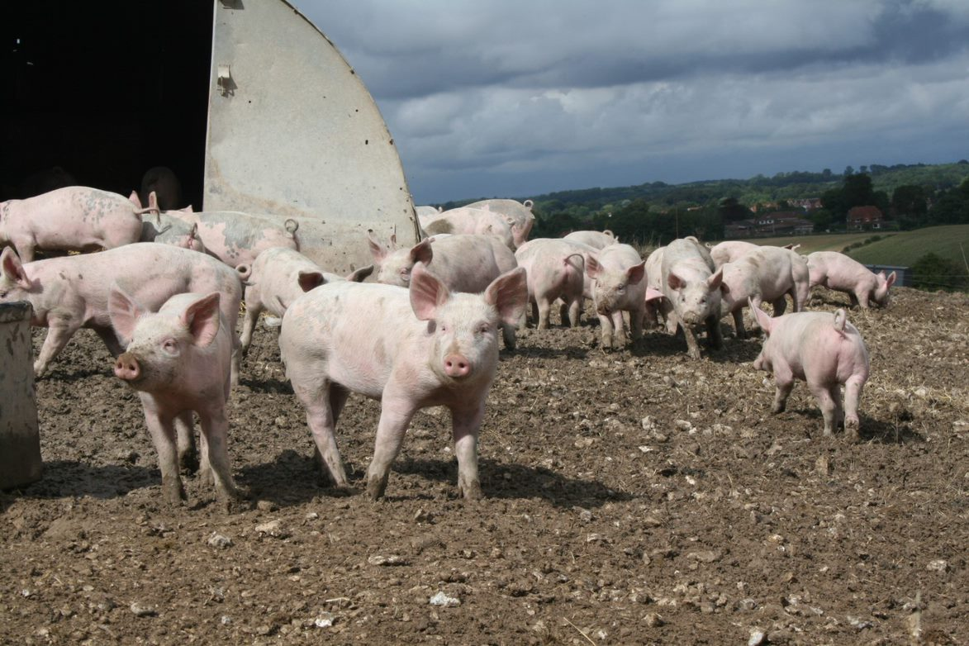
Free-range...
The pigs are free to run and play.
The pigs can always go outdoors.
The pigs can display their natural behaviours. They can root and forage in straw and outdoor land.

Slide 25
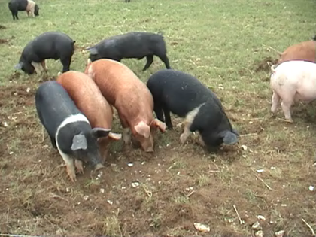
Organically...
In the UK, pigs that are organic are also free-range.
The pigs can always go outdoors.
The pigs are free to run and play.
The pigs can display natural behaviours. They can root and forage in straw and outdoor land.
The pigs are fed organic food.

Slide 26
Which do you think is the best and why?
Rank them, with 1 being the best and 4 being the worst.
On bare floors
On straw
Free-range
Organically
What was your number 1?
2?
3?
4?
Notes:
Show
Then ask what they were doing.
Could they do this inside in a shed?

Slide 27
Watch this video of pigs on a free-range farm!
https://www.youtube.com/watch?v=x-3mKSbyZBw
Do you think these pigs could display all of these behaviours in each of the farming systems we have looked at?
Notes:
Show
Then ask what they were doing.
Could they do this inside in a shed?

Slide 28
How can we change how our pigs live?

Slide 29
Another happy video to end with...
https://www.youtube.com/watch?v=yM8q1_uFKXI

